Slide 1
Asset Management System
User Guide Version 2.0 – 5/23/2024

Slide 2
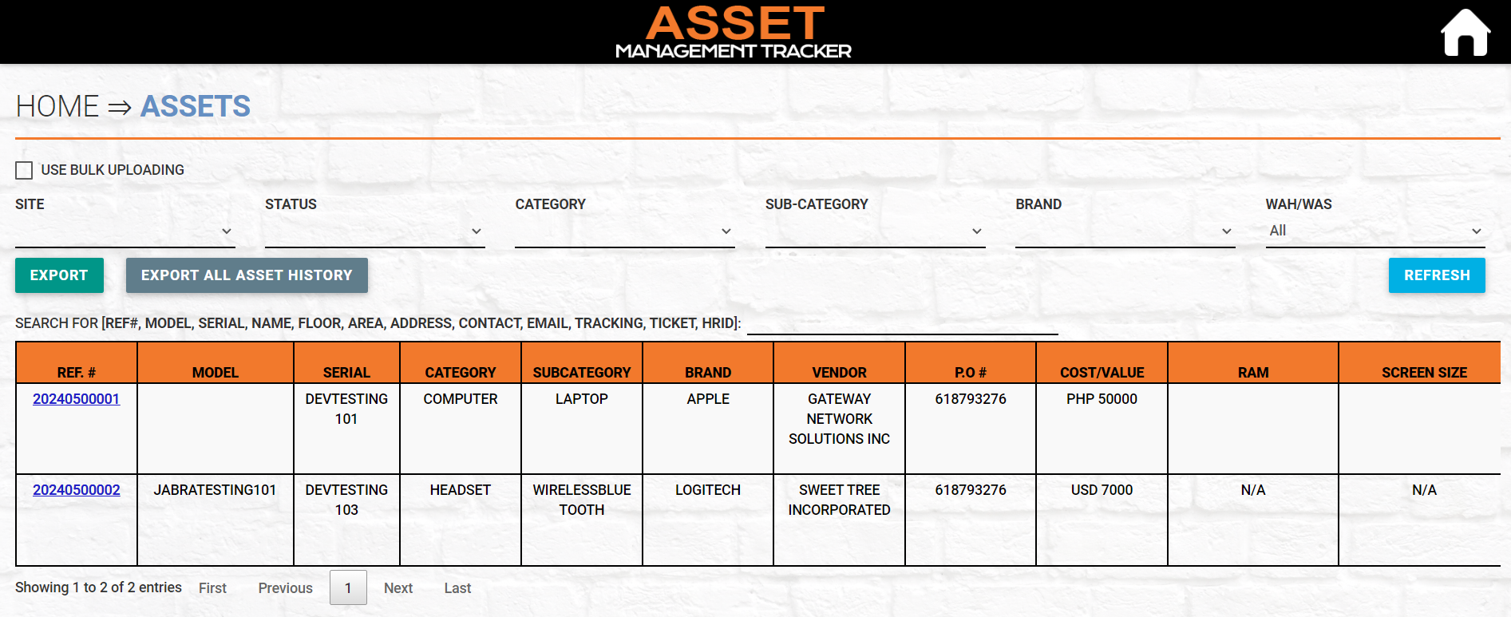
MAIN PAGE
Used to bulk upload Assets
Filter list of Assets

Slide 3
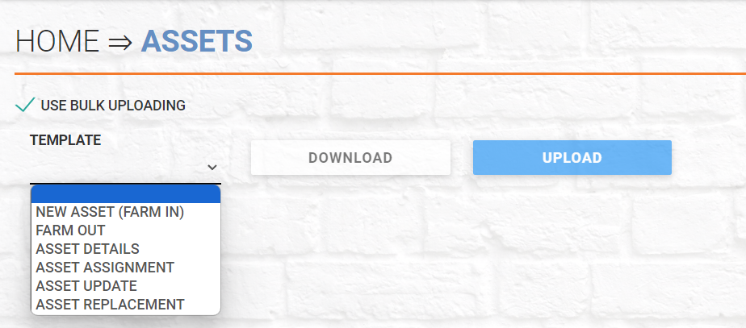
NEW ASSET(FARM IN)
1
2 Choose New Asset (Farm In) and Download
Click to upload
3 Fill out the template and upload

Slide 4
FARM OUT
1
2 Choose Farm Out and Download
Click to upload
3 Fill out the template and upload

Slide 5
ASSET DETAILS
1
2 Choose Asset Details and Download
Click to upload
3 Fill out the template and upload

Slide 6
ASSET ASSIGNMENT
1
2 Choose Asset Assignment and Download
Click to upload
3 Fill out the template and upload

Slide 7
ASSET UPDATE
1
2 Choose Asset Update and Download
Click to upload
3 Fill out the template and upload

Slide 8
ASSET REPLACEMENT
1
2 Choose Asset Replacement and Download
Click to upload
3 Fill out the template and upload

Slide 9
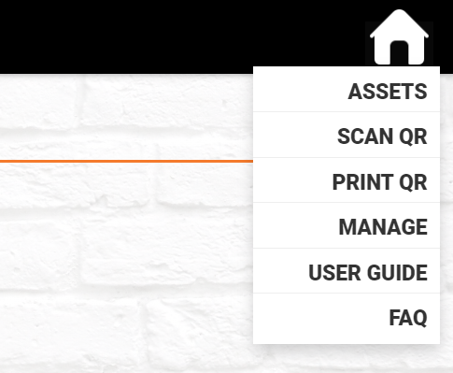
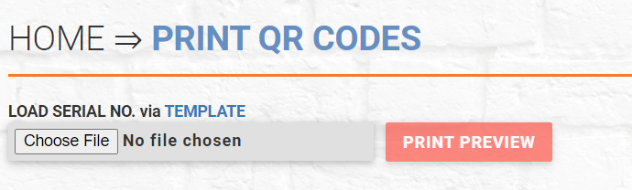
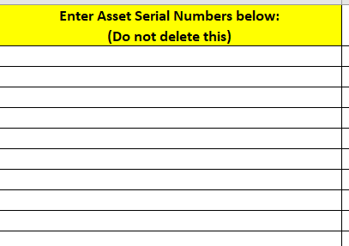
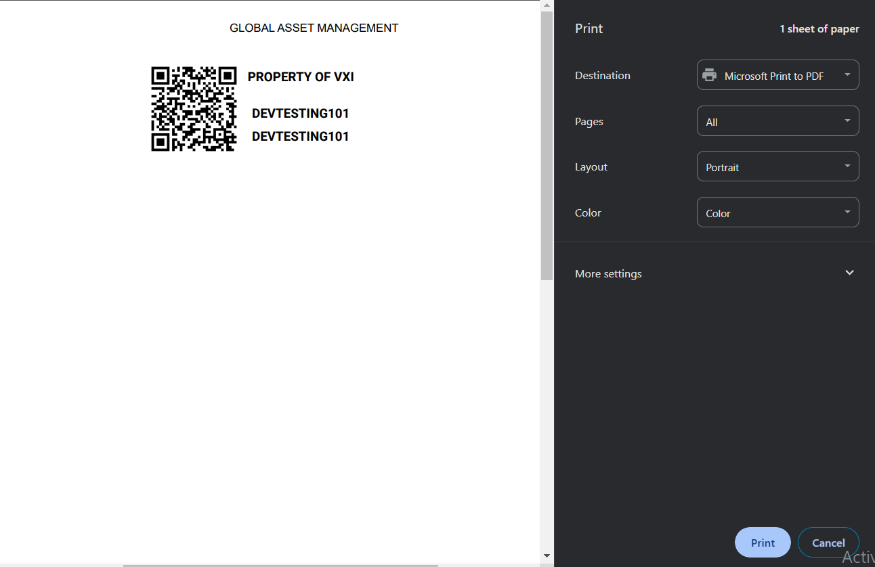
PRINT SERIALS
1
2
3
Click the house icon and
select PRINT QR
Click TEMPLATE to Downlaod
Fill out Template and
Upload
4
Click PRINT PREVIEW
5
Click PRINT to Print

Slide 10

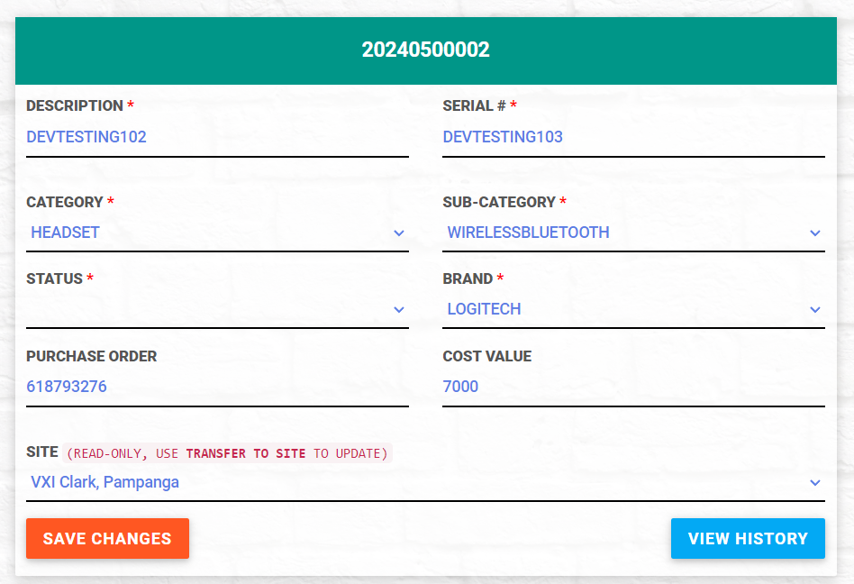
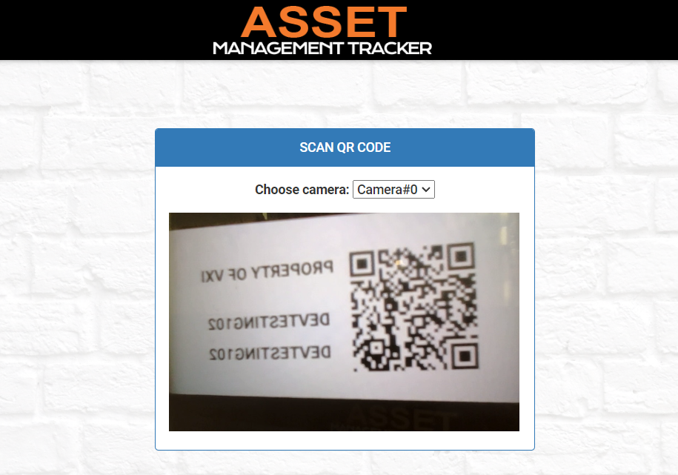
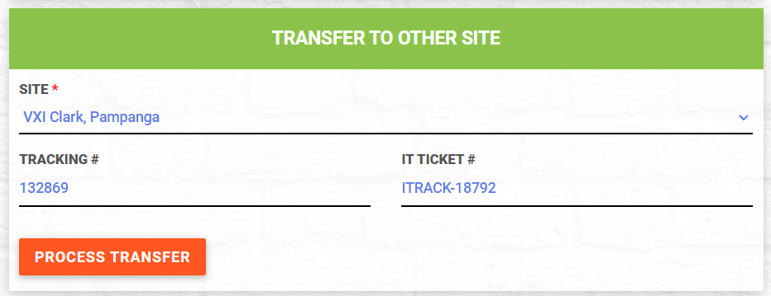
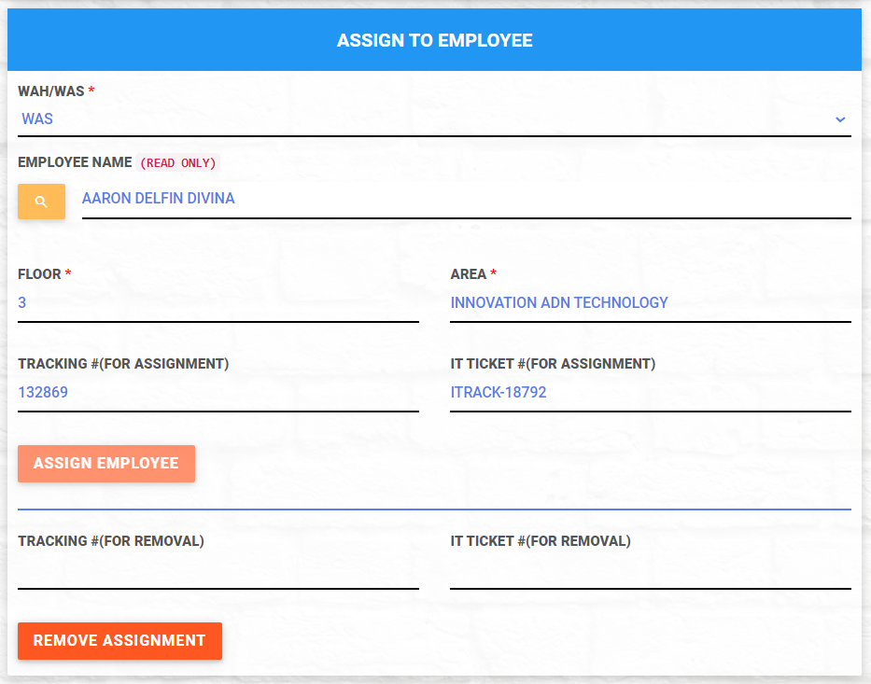
Scan Asset QR code using the Tablet to view details about the asset
SCANNING

Slide 11
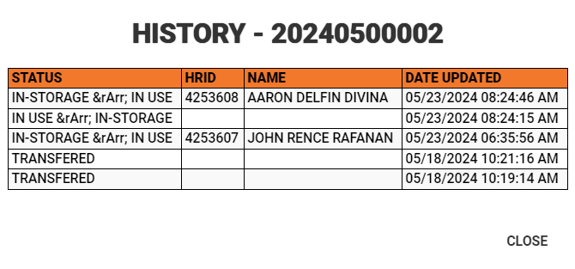
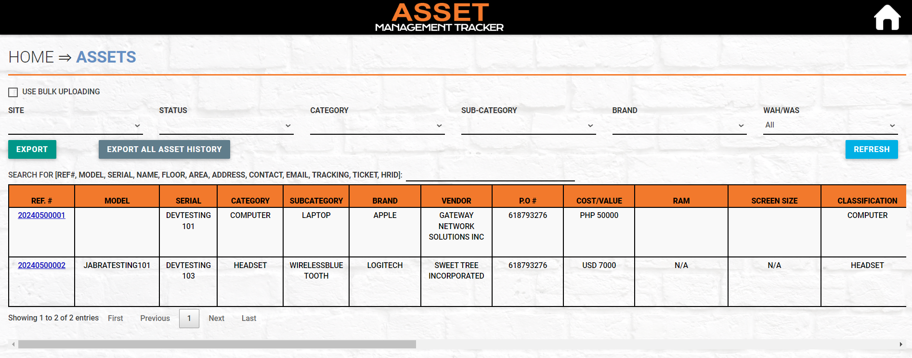
ASSET HISTORY
Asset Ref. #
Select Asset Ref. #, to view the list of historical changes made in the Asset

Slide 12
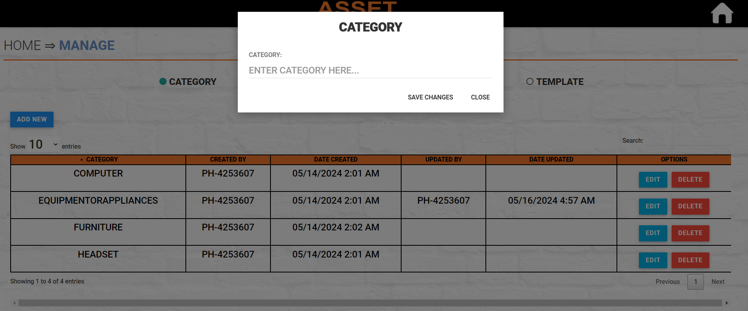
MANAGE - CATEGORY
2
3
1
1. Click ADD NEW
2. Enter desired Category
3. Click SAVE CHANGES to add the
category on the list

Slide 13
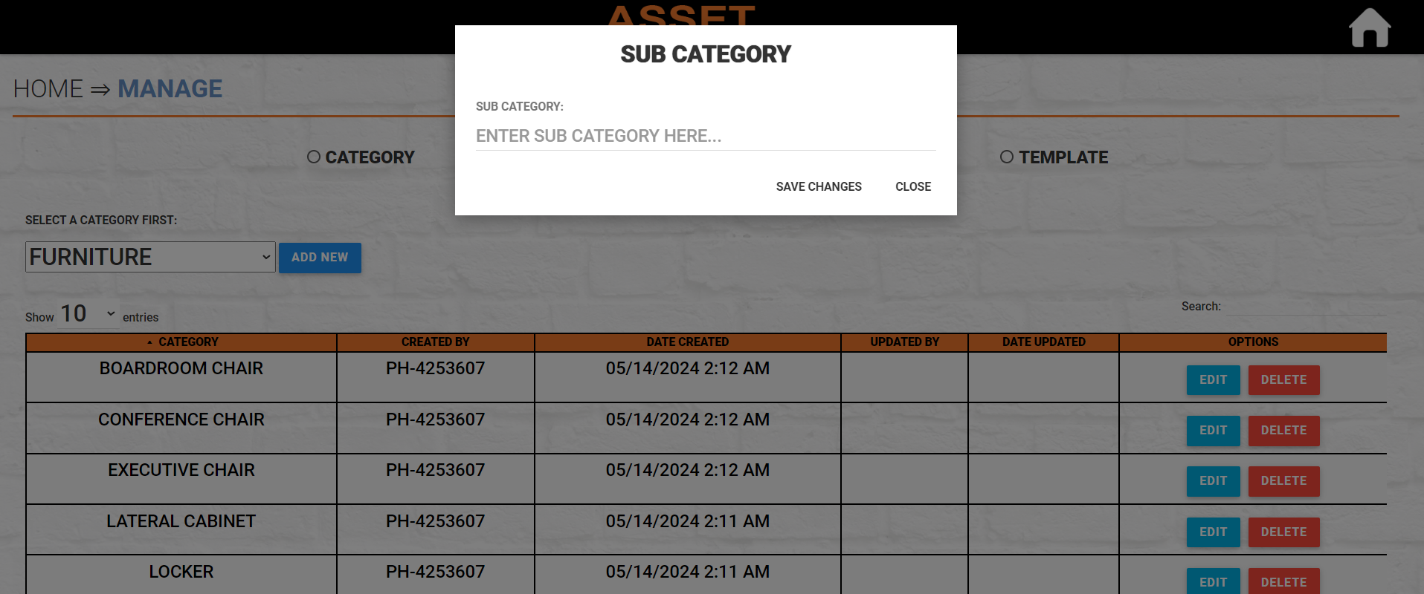
MANAGE - SUBCATEGORY
3
4
2
1
1. Select a Category
2. Click ADD NEW
3. Enter desired Sub Category
4. Click SAVE CHANGES to add the sub
category on the list

Slide 14
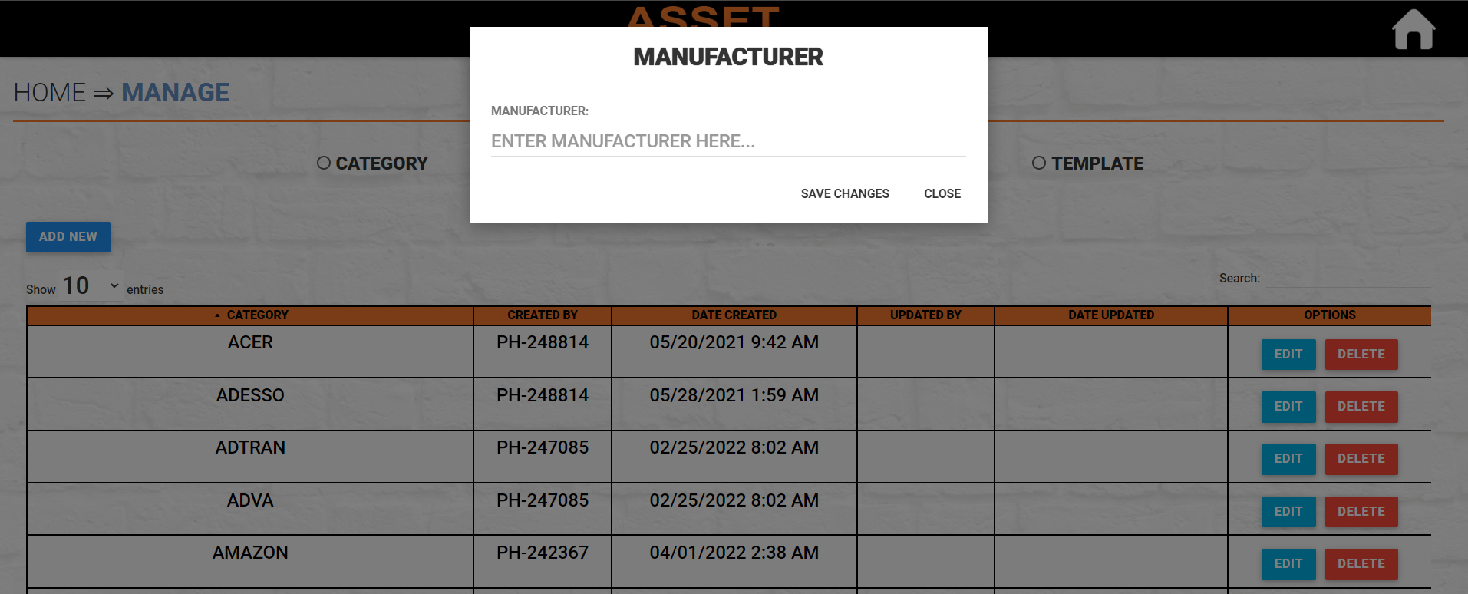
MANAGE - MANUFACTURER
2
1
3
1. Click ADD NEW
2. Enter desired Manufacturer
3. Click SAVE CHANGES to add the
category on the list

Slide 15
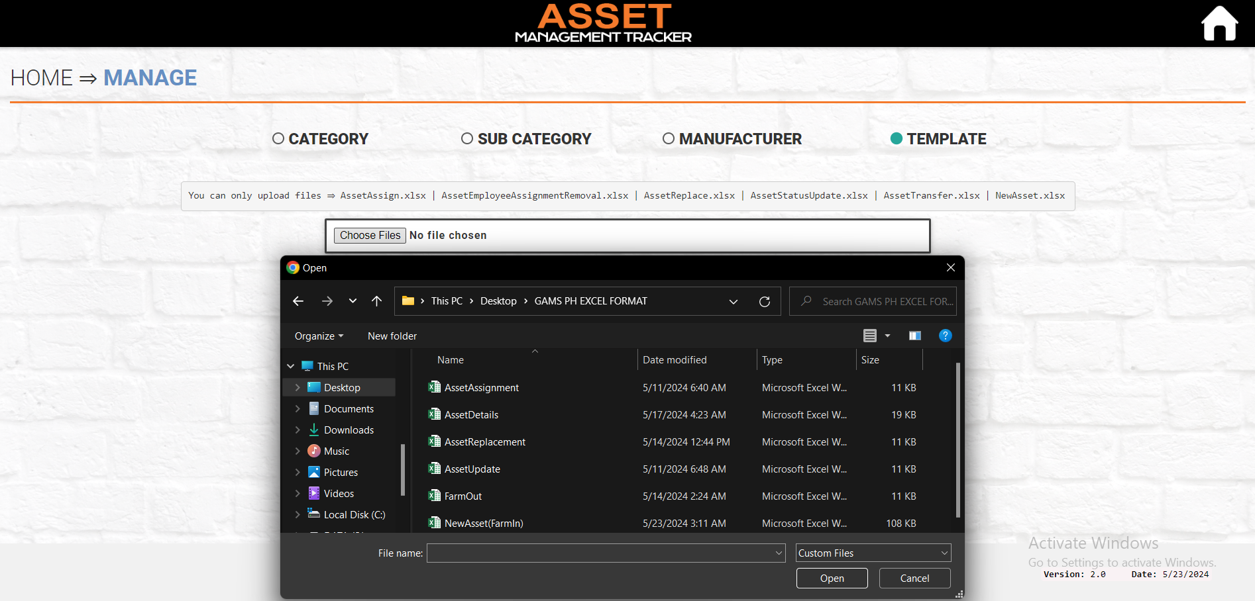
MANAGE - TEMPLATE
1
2
1. Click Template
2. Click Choose Files
3. Select the templates to upload
4. Click Open to process the uploading
3
4

Slide 16
Thank you!

